Slide 2
Over 36 million Americans Suffer from Hearing Loss!
That is over 4 times
the amount of people living in New York City!

Slide 3
“As a member of this profession (medical), a physician must recognize responsibility to patients first and foremost….” AMA Principles of Medical Ethics (2001)

Slide 4
Noise-Induced Hearing Loss (NIHL)
NIHL is permanent, preventable, and occurs in people of all ages.
With the increased popularity and use of personal MP3 players, and the world we live in getting louder, Americans are suffering from hearing loss at younger ages.
NIHL is a form of sensorineural hearing loss, similar to what we experience as we age.

Slide 5
Over 18 million Americans who suffer from hearing loss are younger than age 65.
Over 5 million are children and young adults under the age of 18 who suffer from
Noise-Induced Hearing Loss.

Slide 6
Noise levels or loudness are measured in decibels (dB).
Any loud noise over 85dB is considered loud enough to cause NIHL.
30 dB Whisper
60 dB Normal conversation or a dishwasher
70 dB A vacuum Cleaner
80 dB Alarm Clock
90 dB A hair dryer, or lawn mower
100 dB MP3 players at full volume
110 dB Concerts and sporting events
130 dB Ambulance

Slide 7
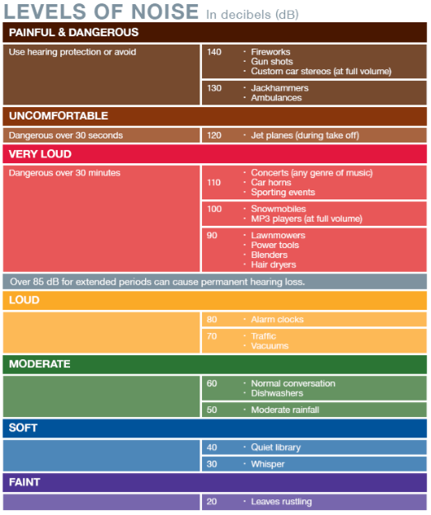
The Academy offers a free copy of the Levels of Noise chart, as a tool to educate patients about safe decibels levels and exposure time.

Slide 8
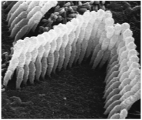
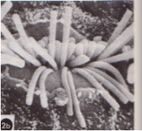
NIHL (Noise-Induced Hearing Loss)
Once the cilia in the organ
of Corti become bent,
disorganized, and broken
they can never be repaired.
Some signs of NIHL are:
Ringing in the ears (tinnitus).
People sound like they are mumbling.
Difficulty hearing and understanding speech in personal, school, and work environments.
From David J. Lim. Functional Structure of the Organ of Corti: A Review. Hearing Research, 22 (1986) 117-146 Elsevier

Slide 9
Hearing Loss Can Decrease Quality of Life!
The first symptoms of
NIHL are often overlooked
because a patient may be
compensating for the
gradual loss.
However, the compensation
changes made by the patient
often decreases his or her quality of life.
Patient quits going to restaurants and other social gatherings, because of his or her difficulty to hear.
Patient finds him or herself increasing the volume on the TV, radio… to be able to hear.
Patient may argue with family and friends due to the inability to communicate easily.

Slide 10
People with untreated hearing loss (people with hearing loss who do not wear hearing aids) experience a decreased quality of life. Sadness Depression Anxiety Paranoia Poor Social Relationships

Slide 11
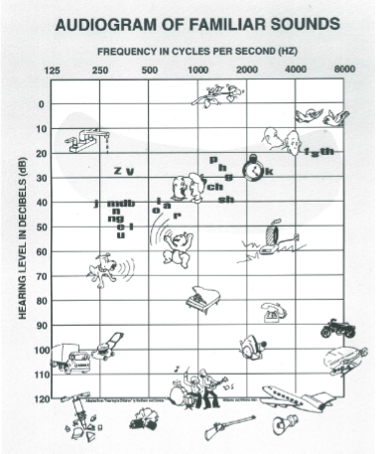
If You Think Your Patient Has a Hearing Loss?
Refer him or her to an audiologist to get a hearing evaluation.
Audiologists will run a diagnostic hearing evaluation in a sound booth to determine the hearing loss.
The results are noted on an audiogram that illustrates the softest sounds a patient can hear.

Slide 12
Protecting Your Hearing
Educate patients on the 3 basic hearing protection methods.

Slide 13
Walk Away
If the noise is too loud, you don’t have to be near it. Walk away!
Moving back 10 to 15 feet from the noise can reduce the intensity that is going into the ears.
Avoiding loud sounds can be a highly effective approach for protecting your hearing.
Encourage patients to use the level of noise chart to learn what decibel levels are safe for what period of time without ear protection.

Slide 14
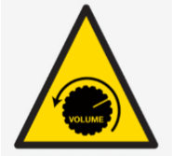
Turn It Down
TVs, car stereos, and MP3 players are often culprits of dangerously high noises.
Most volume controls do not have a safety point for when the (dB) level is too high.
Turning down the volume will reduce prolonged exposure to harmful decibels.
Encourage patients to keep the volume at 50%.
When listening to anything with ear buds or ear phones: if someone next to you can hear what you are hearing,
the volume is probably too loud.

Slide 15
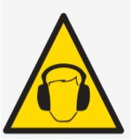
Wear Ear Protection
If you know you are going to be around noise over 85 dB, the best solution is to wear ear protection.
Generic earplugs – Must be pushed far in the ear for the best seal.
Custom earplugs (made to fit your ear)
See your audiologist for these, similar to what musicians and pilots wear.
Earmuffs- must cover the full ear.
NOT FASHION EARMUFFS
Look for the NRR rating to know the approximate decibel reduction the ear protection provides.

Slide 16
The following Web site is available as a consumer resource for your patients. www.HowsYourHearing.org

