Slide 1
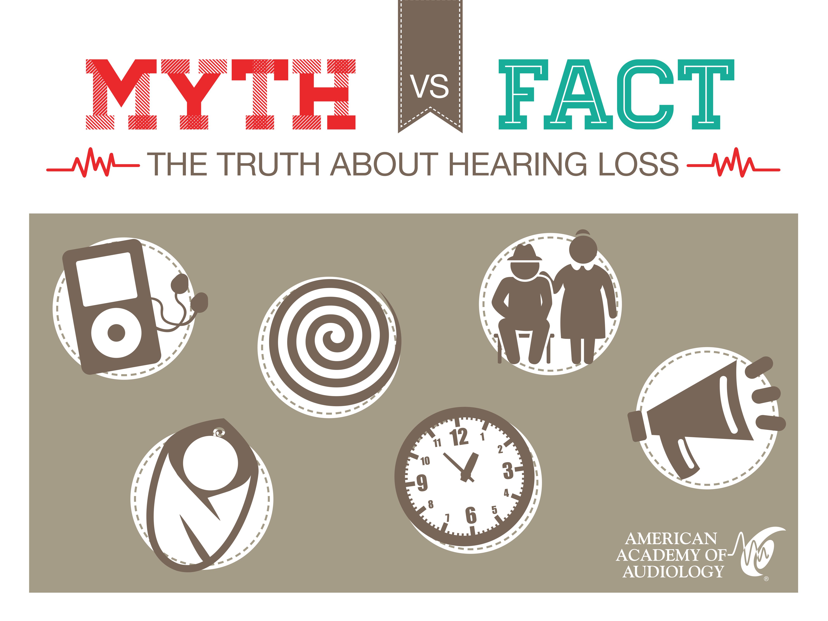

Slide 2
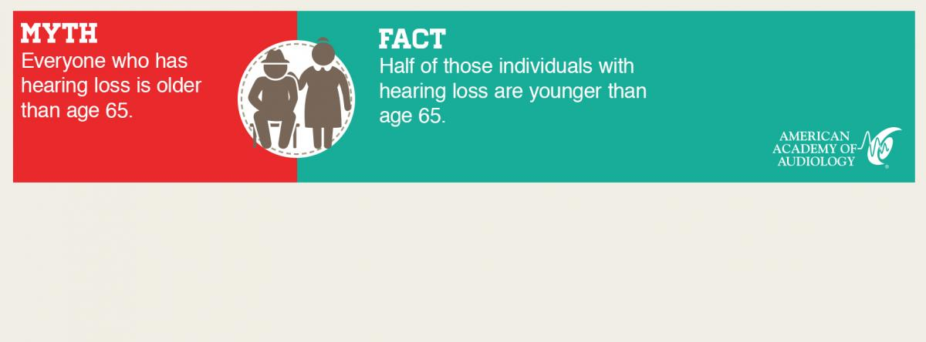

Slide 3
Over 36 Million Americans
Suffer from Hearing Loss!
That is over 4 times
the amount of people living in New York City!
Over 21 million are between the
ages of 18 and 64.

Slide 4
Over 5 million American children and young adults under the age of 18 suffer from
noise-induced hearing loss.

Slide 5
“As a member of this profession (medical), a physician must recognize responsibility to patients first and foremost…”
AMA Principles of Medical Ethics (2001)

Slide 6
When to Refer to an Audiologist
If you, the patient, or the patient’s family member notice any of the
following signs, refer him or her to a local audiologist for a diagnostic
hearing evaluation.
  Signs of Hearing Loss:
  Patient regularly asks to have things repeated
  Patient has significantly better hearing in one ear compared to the other.
  Patient (infant) has failed the Newborn Hearing Screening test.
  Patient has been prescribed or exposed to ototoxic medications.

Slide 7
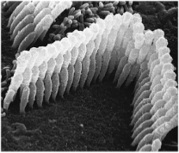
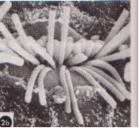
Hearing Loss: In General Terms
  The most common forms of
  hearing loss result from
  damaged or broken hair cells
  in the cochlea.
  Once the hair cells are
  damaged or broken, there is no treatment or surgery to repair them.
  Hearing aids can improve
  audibility but will not restore
  hearing to what it once was.

Slide 8
Symptoms that Indicate a
Larger Audiological Problem
  A Sudden Hearing Loss in one or both ears.
  Acute or chronic Vertigo, Dizziness, or Imbalance.
  A Ringing or Buzzing in the Ears :Tinnitus.
  A Fullness or Pressure in the Ears.
  A Speech/Language Delay in children.

Slide 9
Sudden Hearing Loss
Sudden sensorineural hearing loss (SSNHL) will typically happen to a patient in one ear over a period of one to several days (can also affect both ears).
Patient may report:
    A feeling of fullness in the affected ear.
    A ringing, roaring, or buzzing tinnitus in the affected ear.
    A feeling of dizziness or vertigo.
    An upper respiratory infection prior to the hearing loss.
Diagnosis of SSNHL can only be made after a full hearing test is performed and an asymmetric hearing loss is confirmed.

Slide 10
Sudden Hearing Loss
After an audiologist has diagnosed the patient with SSNHL, an otolaryngologist may order an MRI to rule out a vestibular schwannoma (acoustic neuroma).
SSNHL treated with steroids within the first 2 weeks of the symptoms provides a patient with the best chance that some of the hearing may return.

Slide 11
Vertigo, Dizziness, or Imbalance
  Electronystamography (ENG)
  Videonystagmography (VNG)
  Rotary Chair
  Auditory Brainstem Response (ABR)
  Posturography
  Vestibular Evoked Myogenic Potentials (VEMP)
  Electrocochleography (ECOG)
Vertigo, dizziness, and
imbalance in patients can be symptoms of an inner ear problem.
Audiologists can
perform assessments on
the balance system
with the following tests:

Slide 12
Vertigo, Dizziness, or Imbalance
50% of dizziness reports are the result of an inner ear disorder called benign paroxysmal positional vertigo (BPPV).
BPPV is caused by dislodged otoconia in the vestibular ducts.
An audiologist can observe the BPPV during a maneuver
called the Dix-Hallpike test.
After BPPV has been diagnosed, an audiologist can help the patient by performing the canalith repositioning maneuver or the Epley maneuver to move the otocionia back into place.

Slide 13
Vertigo, Dizziness, or Imbalance
Dizziness reported with tinnitus, ear pressure, and decreased hearing may, indicate an inner ear condition such as:
    Labrynthitis
    Meiner’s Disease
    Cochlear Hydrops
A permanent peripheral vestibular disorder that interrupts the patient’s daily function may be improved by vestibular therapy performed by an audiologist.

Slide 14
Ringing or Buzzing in Ears: Tinnitus
Tinnitus represents one of the most elusive conditions facing audiologists and other hearing health-care professionals. It refers to an auditory perception of sound not produced by an external source.
  As many as 50 million adults experience tinnitus.
  More than 10 million are seeking help for the condition.

Slide 15
Ringing or Buzzing in Ears: Tinnitus
Tinnitus, like pain, is subjective.
Two individuals experiencing tinnitus may report similar characteristics, yet be affected in significantly different ways.
Many tinnitus sufferers report:
    Interference with sleep
    Interference with concentration
    Interference with attention to detail
    Depression and anxiety
    An inability to tolerate moderate levels of noise (hyperacusis)

Slide 16
Ringing or Buzzing in Ears: Tinnitus
The exact mechanism underlying tinnitus is unknown.
It is likely that there are many mechanisms, however some of the potential causes are:
    Disorders in the outer ear
    Disorders in the middle ear
    Disorders in the inner ear
    Temporary effects from high dosages of medications such as anti-inflammatories, certain sedatives, and antidepressants
    Possible permanent effect from certain antibiotics and chemotherapeutic agents
    Systemic disorders
    Trauma to the head or neck, cervical problems, and temporomandibular misalignment

Slide 17
Ringing or Buzzing in Ears: Tinnitus
While there is no cure for most forms of tinnitus, a variety of management approaches exist.
An audiologist can help you and your patient with the following management approaches:
    Hearing Aids
    Masking
If your patient reports a gradual increase of the tinnitus in one ear, it could be a sign of hearing loss in that ear.
The patient should be referred to an audiologist.

Slide 18
Feeling of Fullness or
Pressure in the Ears
Some common causes of this in patients are:
  Eustachian tube dysfunction (ETD)
  If associated with dizziness, it could be caused by pressure from the inner ear fluid (perilymph fistula).
  If associated with temporary mild to moderate hearing loss, it could be caused by an acute or chronic middle ear condition.
An audiologist can diagnose the patient and recommend appropriate treatment after a full hearing and Eustachian tube evaluation.

Slide 19
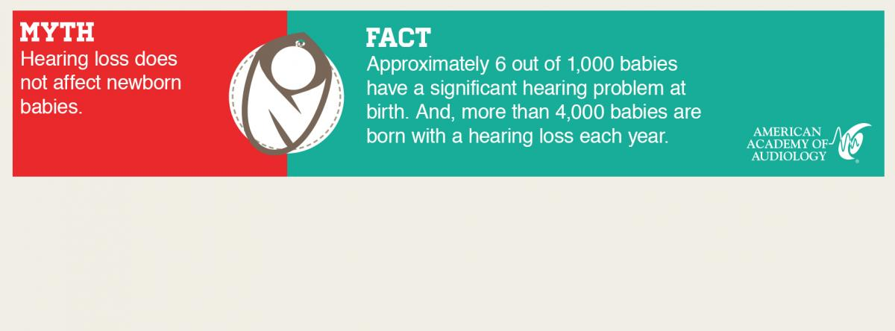

Slide 20
Speech/Language Delay
Hearing loss in infants is a hidden disability. It is important to note missed developmental milestones and refer for audiological evaluation if any delay is suspected. All infants who fail or missed newborn hearing screening should be referred immediately to an audiologist for full evaluation.
An infant with normal hearing should be able to do the following:
  2 months: Startle to loud sounds, quiet to familiar voices, and make vowel sounds similar to “ohh.”
  4 months: Look for sound sources, squeal and chuckle, and begin to babble.
  9 months: Imitate speech sounds of others, understand “no-no” or “bye-bye”, and turn head towards soft sounds.
  12 months: Correctly use “ma-ma” or “da-da”, give toys when asked, and responds to singing or music.

Slide 21
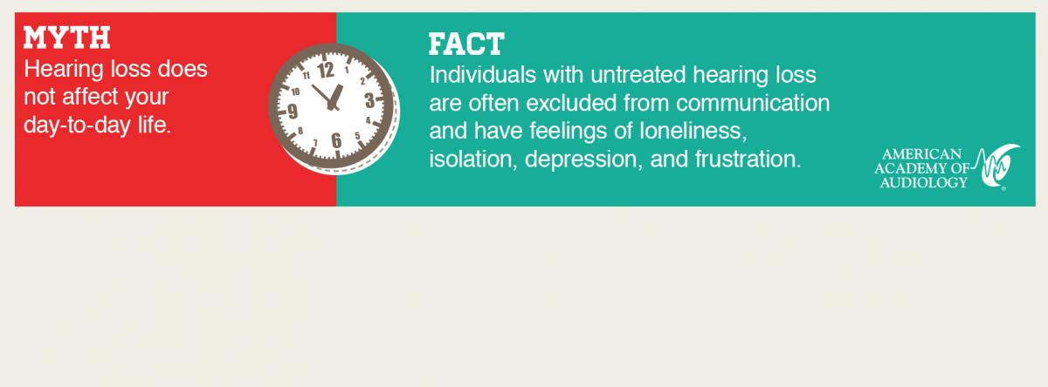

Slide 22
The following Web site is available as a consumer resource for your patients. www.HowsYourHearing.org

