Slide 1


Slide 2

Source: www.who.int/mediacentre/factsheets/fs300/en

Slide 3
Pursue one of the top-rated careers in the country* and…
Provide a vital health service.
Combine science, technology, community service, research, education, and patient care into one satisfying career.
Improve quality of life, educate your community, and offer preventative health care.
Be part of a rapidly growing profession with faster than average projected growth.
Help people of all ages hear and communicate better with spouses, family, friends, and co-workers.
*Sources: http://time.com/3935051/best-job-america, www.forbes.com/pictures/mkl45ejejl/the-best-jobs-for-2015, http://money.usnews.com/careers/best-jobs/audiologist

Slide 4
FACT
Audiologists are doctoral-level, health-care professionals who evaluate, diagnose, treat, and manage hearing loss, tinnitus, and balance disorders across all ages.

Slide 5
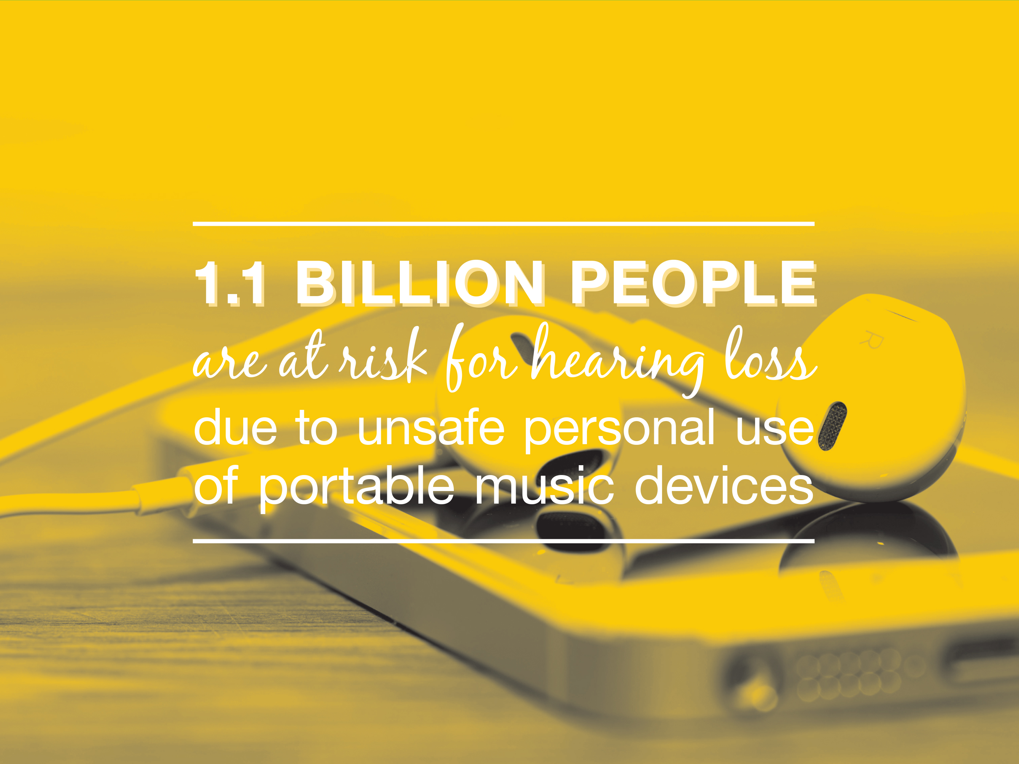
Source: www.who.int/mediacentre/news/releases/2015/ear-care/en/

Slide 6
Where Can a Career in
Audiology Take Me?
Audiology offers a wide variety of career paths and job settings.
You can be an entrepreneur and own a private practice or work for an international hearing solutions company.
Want to do something else? There are many options and opportunities.

Slide 7
Audiology Career Paths
Private Practice Owner
Clinical Audiologist or Specialist
Academic Faculty
Researcher
Manufacturer
Forensic Audiologist
Occupational Health
Educational Audiologist
Intraoperative Monitoring

Slide 8
Audiology Job Settings
Clinics
Colleges and Universities
Hearing Health-Care Manufacturing Companies
Hospitals
Private Practices
Research Facilities
Schools
Military and Government Agencies

Slide 9
FACTS
Depending on work setting and location, audiologists earn an average salary of $73,060 annually, with the potential to earn more than $100,000 annually.
Audiology is expected to grow by at least 29 PERCENT, which is much faster than the average for other career fields.
Source: www.bls.gov/ooh/healthcare/audiologists.htm

Slide 10
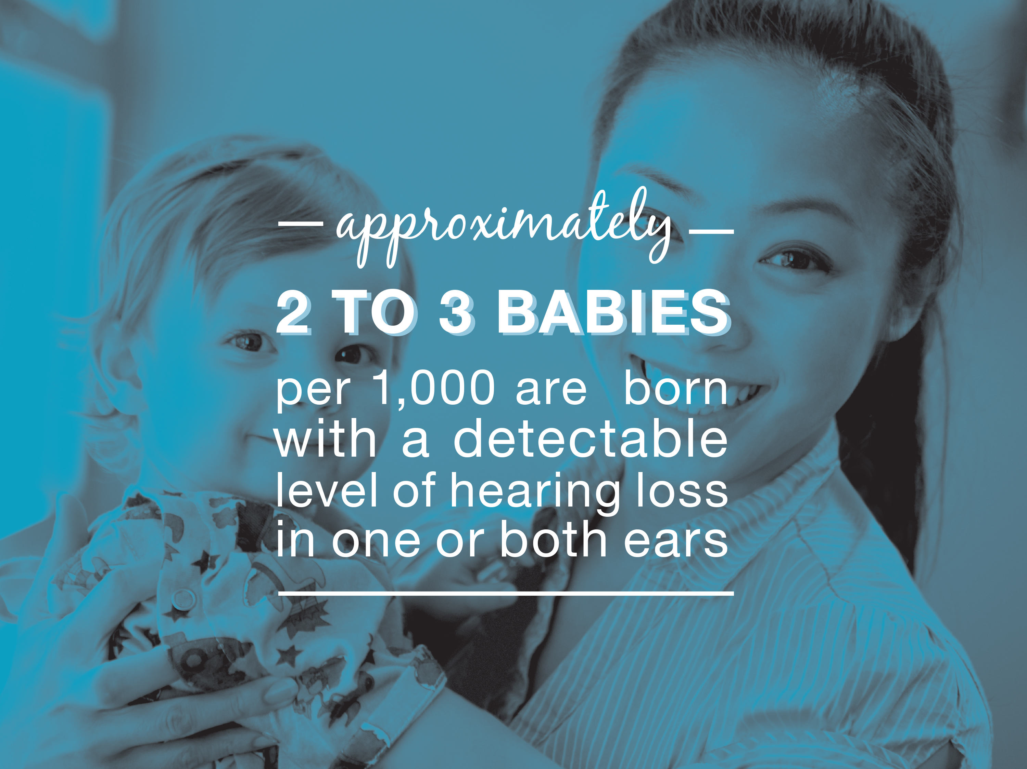
Source: www.nidcd.nih.gov/health/statistics/pages/quick.aspx

Slide 11
What Can I Do to Prepare for a Career in Audiology?
Find out more about the profession…shadow or volunteer with a local audiologist. Visit www.audiology.org and search the “Find an Audiologist” directory to locate an audiologist in your area.

Slide 12
What Can I Do to Prepare for a Career in Audiology?
Consider an undergraduate degree in speech and hearing sciences or other science-related degrees such as biology, physics, chemistry, psychology, and engineering.

Slide 13
What Can I Do to Prepare for a Career in Audiology?
Obtain a doctoral degree in audiology. Audiology graduate programs include coursework in anatomy, physiology, physics, genetics, normal and abnormal communication development, diagnosis and treatment options, pharmacology, and ethics.

Slide 14
What Can I Do to Prepare for a Career in Audiology?
A doctor of audiology (AuD) degree is the minimal entry-level degree.
AuD programs are three to four years and prepare students to work directly with patients in clinical practice.

Slide 15
What Can I Do to Prepare for a Career in Audiology?
A PhD in speech and hearing sciences or a related field prepares students for a career in academia or research. Length of PhD programs vary and will include training in research methods, design, and statistics.
Several programs offer dual degrees that combine the AuD and PhD tracks for students interested in practicing multiple career paths.

Slide 16
What Can I Do to Prepare for a Career in Audiology?
There are 73 doctoral programs in audiology and/or related hearing science in the United States. Visit www.audiology.org and search keywords “doctoral programs” to find a graduate program that fits your career goals.

Slide 17
GAIN REWARDING EXPERIENCE
and
PRACTICE CUTTING-EDGE HEALTH CARE
IN A
CHANGING TECHNOLOGICAL WORLD
WITH A CAREER IN AUDIOLOGY.
For more information, visit our student Web site www.studentacademyofaudiology.org and go to the “Educational Opportunities” tab where you will see “Doctoral Students.”

